Slide 1
Discover Volvox Development (DVD)
How to manual for mutant screening and documentation

Slide 2
Objectives
Learn about Volvox biology and its life cycle
Learn about how studying Volvox contributes to understanding the evolution of multicellularity.
Learn about mutagenesis and the importance of studying mutants in developmental biology.
Examine Volvox colonies (i.e. individuals or spheroids) and identify mutants produced by UV mutagenesis.
Document relationships between UV light doses, Volvox viability, and rate of mutagenesis.
Document mutants on Instagram and or Google classroom.
Send requested mutants back to Danforth Center for possible further study.

Slide 3
List of equipment and supplies
Volvox culture
Volvox cultures (populations)*
LED or grow light (optional)
Wire shelf (optional)
Timer switch (optional)
Water bath (optional)
Standard Volvox Medium*
Glass culture tubes* and tube racks*
Volvox mutant screening
multi-well plates*
Sharpie
Dissecting microscope*
Pipettes*
Petri dishes*
Phone or microscope camera for documentation
UV mutagenesis (optional)
UV crosslinker/UV handlamp
Aluminum foil
Tape
* Danforth Center can provide

Slide 4
Hands-on: Screening for Volvox mutants

Slide 5
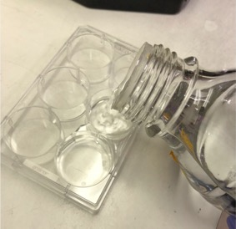
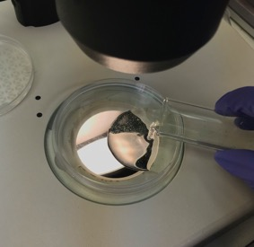
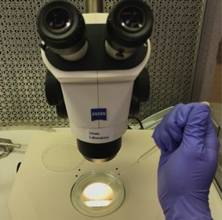
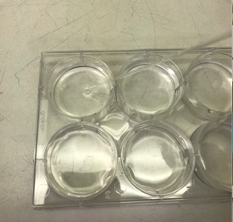
Volvox mutant screening (1)
Pour standard volvox medium into one or more 6-well plates and set aside.
Pour or pipet some of the mutagenized population into a petri dish.
Look for mutant spheroids under the dissecting microscope. Use the field guide and see whether you can find known types or new ones.
Transfer single mutants to the multi-well plate with pipets (one mutant per well). See video and tips on next slide.

Slide 6
Isolating single spheroids for further analysis
This video shows a somewhat disintegrated colony (a.k.a. spheroid/individual) being carefully drawn into a Pasteur pipette and then re-deposited into another drop of liquid. After doing this, the second drop of liquid can be examined to make sure only one individual is there.
Tips for Success
Practice first on some randomly chosen spheroids to hone your pipetting skills.
After drawing up a single Volvox (spheroid), redeposit it in a small drop of liquid on a new clean petri plate or on the inverted lid of the one you are using.
Check to see if the droplet has the Volvox individual you chose and if there are some others that came along for the ride.
If you have additional unwanted Volvox colonies add a little more liquid to the droplet to dilute and try to capture the Volvox individual of interest again.
Repeat above until you have a single individual that can be transferred to the six well plate.

Slide 7
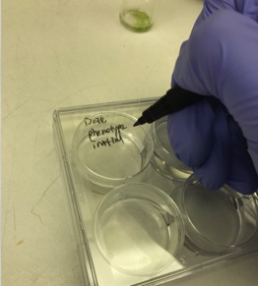
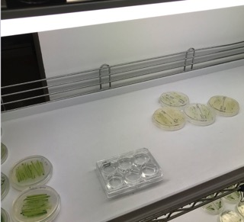
Volvox mutant screening (2)
Reminders
Take detailed notes at each step (e.g. how many total spheroids you screened from each pool, how many candidate mutants you found, and your guess about the possible mutant phenotype).
Take note of both successes and failures. They both contribute to scientific advances and learning.
Try to get as high-quality images as possible so that others can assess your mutant’s phenotype.
Label each well with date, name, phenotype, and initials.
Incubate mutants under diurnal conditions for 4-6 days and recheck the population to see if the mutant phenotypes were heritable in its offspring.

Slide 8
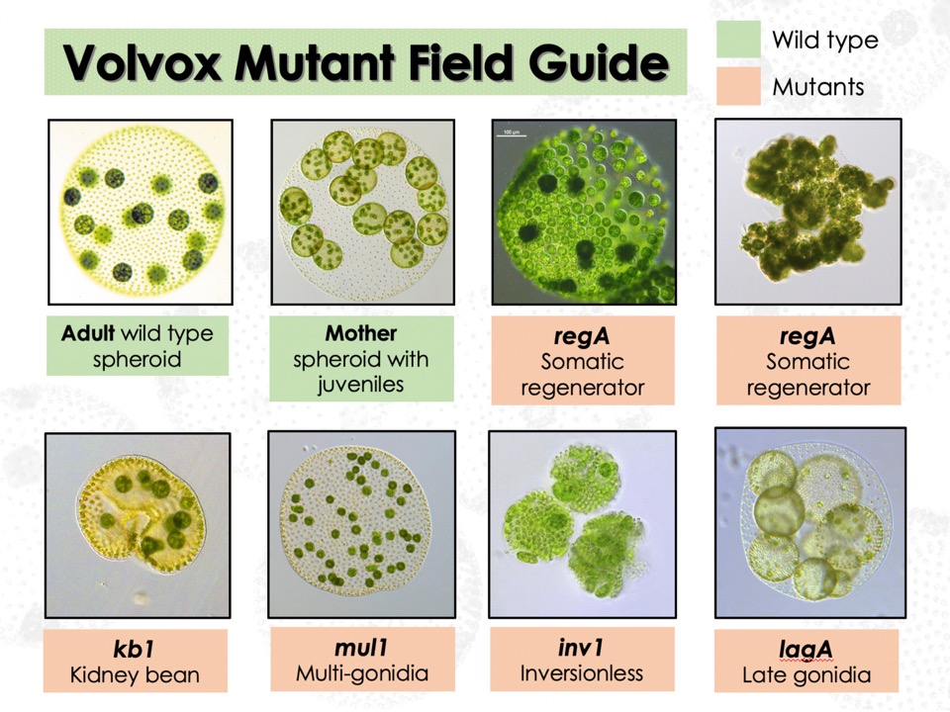

Slide 9
Analyzing Volvox mutagenesis results
Use a population of un-mutagenized individuals to learn what are the spectrum of normal Volvox culture phenotypes
Besides being a mutagen, UV light is also a stressor that can cause irregular development and strange looking spheroids to form. Are these true mutants or developmental “monsters”?
Mutants breed true after picking an individual and letting it propagate. Do you see more mutant-looking offspring in the population after picking a single individual and letting it grow on its own?
Temporary developmental monsters will often give rise to normal looking offspring after they propagate.
Is your mutant a new type, or a previously documented type? Check the field guide. We are especially interested in finding new lag mutants and any other new mutants not in the guide.
lag⁻ mutant reproductive cells (gonidia) show a transient somatic phenotype before re-differentiating as true gonidia. This developmental delay causes lag⁻ gonidial cells to be smaller and more heterogenous in size than wild type gonidia from the same developmental stage.

Slide 10
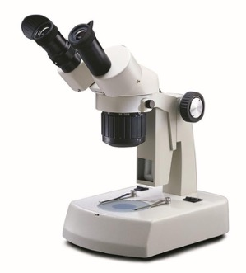
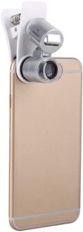
Images and documentation
Tips for success
Smaller drops of SVM keep the Volvox spheroids from moving around too much in the field of view
If the spheroids you want to photograph are still moving too much, try placing the petri plate on a bed of ice or chilling in the fridge to slow them down. Temporary exposure to low temps won’t harm them.
1. Put some colonies of your isolated mutant in a small drop of SVM on a petri dish and find under the dissecting scope
2. Use the mini-microscope phone camera to zoom and take pictures
Take multiple pictures of several individuals from the same mutant. Choose some representative pics that capture the most detail and show the phenotypic range of your mutant.

Slide 11
Upload your discoveries!
DiscoverVolvox@gmail.com
@Discover.Volvox
https://www.instagram.com/discover.volvox/?hl=en

Slide 12
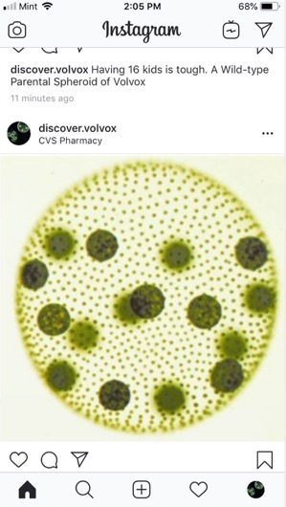
Volvox picture submission guidelines
@discover.volvox
#Mutant name #School name
Please @discover.volvox while uploading Volvox mutant pictures
Timing is important. Post pictures the day they are taken.
We will reach out to you if the mutant needs further characterization.
Notes:
Volvox is very instagramable! Follow us, please!

Slide 13
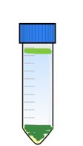
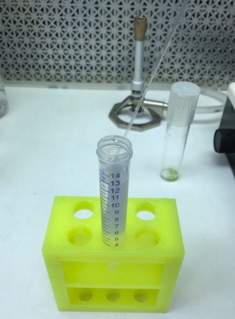
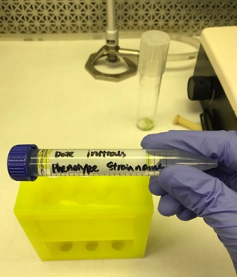
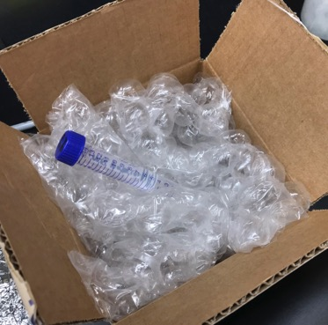
Sample submission (after web submission and solicitation)
6
Transfer interesting mutants to the conical tubes containing SVM (1 type/tube)
Label the tubes with strain names, initials, date, and school
Package properly and arrange a drop off @DDPSC

Slide 14
Contact Information
Project advisor
Dr. James Umen
Principal Investigator
Donald Danforth Plant Science Center
JUmen@danforthcenter.org
Project support
Dr. Sandra Arango-Caro
Education Researcher
Education Research and Outreach Laboratory
Donald Danforth Plant Science Center
Sarango-caro@danforthcenter.org

